Slide 1




































ACADEMIC RESEARCH POSTER TEMPLATE
Subtitle for Academic Research Poster (36x48 inches)
Your names and the names of the people who contributed to this presentation
Introduction
Mauris orci mi, varius id diam id, egestas auctor enim. Praesent ut massa nibh. Duis in et purus neque, facilisis cursus unus di ultrices vel, ullamcorper ac et augue. Donec semper lorem vitae urna pulvinar, et in congue massa.
Data Analysis
Mauris orci mi, varius id diam id, egestas auctor enim. Praesent ut massa nibh. Duis purus neque, [See Figure A]. Donec:
Sed in risus nibh. In nisl quam, aliquet sed nibh sitamet, faucibus placerat dui.
Fusce quis augue scelerisque, luctus rum sed, ut dolor. pulvinar urna in eros posuere.
In elementum orci dignissim. Proin semper.
Results
Mauris orci mi, varius id diam id, egestas auctor enim. Praesent ut massa nibh. Duis purus neque, facilisis cursus ultrices vel, ullamcorper ac augue. Donec semper lorem vitae urna pulvinar, in congue massa tristique quis augue.
Series 1
Series 2
Series 3
Methods
Mauris orci mi, varius id diam id, egestas auctor enim. Praesent ut massa nibh. Duis purus neque, facilisis cursus ultrices vel, ullamcorper ac augue. Donec semper lorem vitae urna pulvinar in congue:
MAURIS ORCI VARIUS ID DIAM
Sed in risus nibh. In nisl quam, aliquet sed nibh sitamet, faucibus placerat dui.
Fusce quis augue scelerisque, luctus rum ut in pulvinar urna in eros posuere.
EUISMOD JUSTO VITAE PURUS
Proin semper ipsum don semper placerat.
Finibus quam tempor, vitae consectetur.
Fusce quis augue scelerisque, luctus rum ut in pulvinar urna in eros posuere.
Series: In et neque dignissim, and in aliquet nisl et umis.
Figure A: In et neque dignissim, and in aliquet nisl et umis.
MAURIS ORCI MI VARIUS ID DIAM Egestas auctor enim. Praesent ut massa nibh. Duis purus neque, facilisis unus cursus an et ultrices vel.
Conclusion
Mauris orci mi, varius id diam id, egestas auctor enim. Praesent ut massa nibh. Duis purus neque, facilisis cursus ultrices vel, ullamcorper ac augue. Donec semper lorem:
Sed Risus Nibh: CiIn nisl quam, aliquet sed nibh sitamet, faucibus placerat dui augue scelerisque.
Curabitur Accumsan Nulla: Fusce quis augue urna scelerisque, luctus rum sed, ut dolor in pulvinar in eros.
Elementum Orci Dignissim: Proin semper ipsum finibus quam tempor, vitae.
MAURIS ORCI MI VARIUS ID DIAM Egestas auctor enim. Praesent ut massa nibh. Duis purus neque, facilisis unus cursus an et ultrices vel.
Graphic Elements
Mauris orci mi, varius id diam id, egestas auctor enim.
Table 1 - Title
8.01 | 7.99 | 5.77 | 6.44
4.50 | 3.11 | 9.55 | 1.12
6.15 | 8.00 | 6.18 | 5.65
8.21 | 2.16 | 3.11* | 7.17
3.00 | 9.70 | 10.50 | 4.45
References
Phasellus nec lectus bibendum, posuere nibh id,
Mauris orci mi, varius id diam id, egestas auctor enim
Duis vitae tincidunt tortor, vitae sollicitudin magna
Aenean et est sem. Phasellus nec lectus bibendum,
Lacinia magna. Mauris orci mi, varius diam id, egestas
Mauris orci mi, varius id diam id, egestas auctor enim
Duis vitae tincidunt tortor, vitae sollicitudin magna
Mauris orci mi, varius id diam id, egestas auctor enim.
*Unamcorper efficitur sed in nulla.
Department or Office name goes here School, College or Division name goes here
buffalo.edu

Slide 3
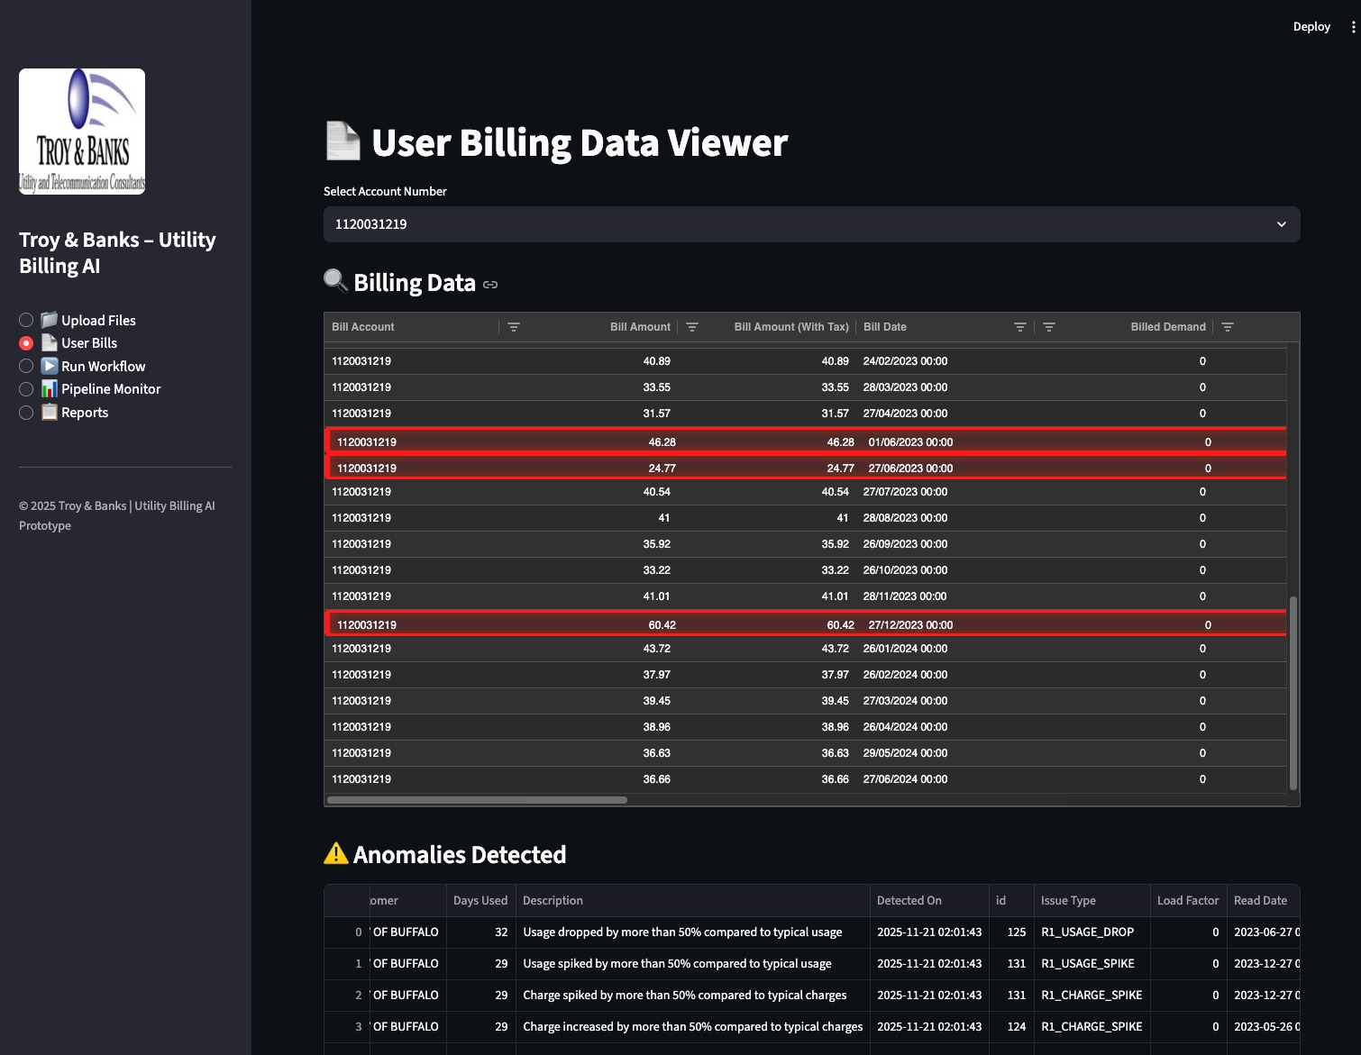
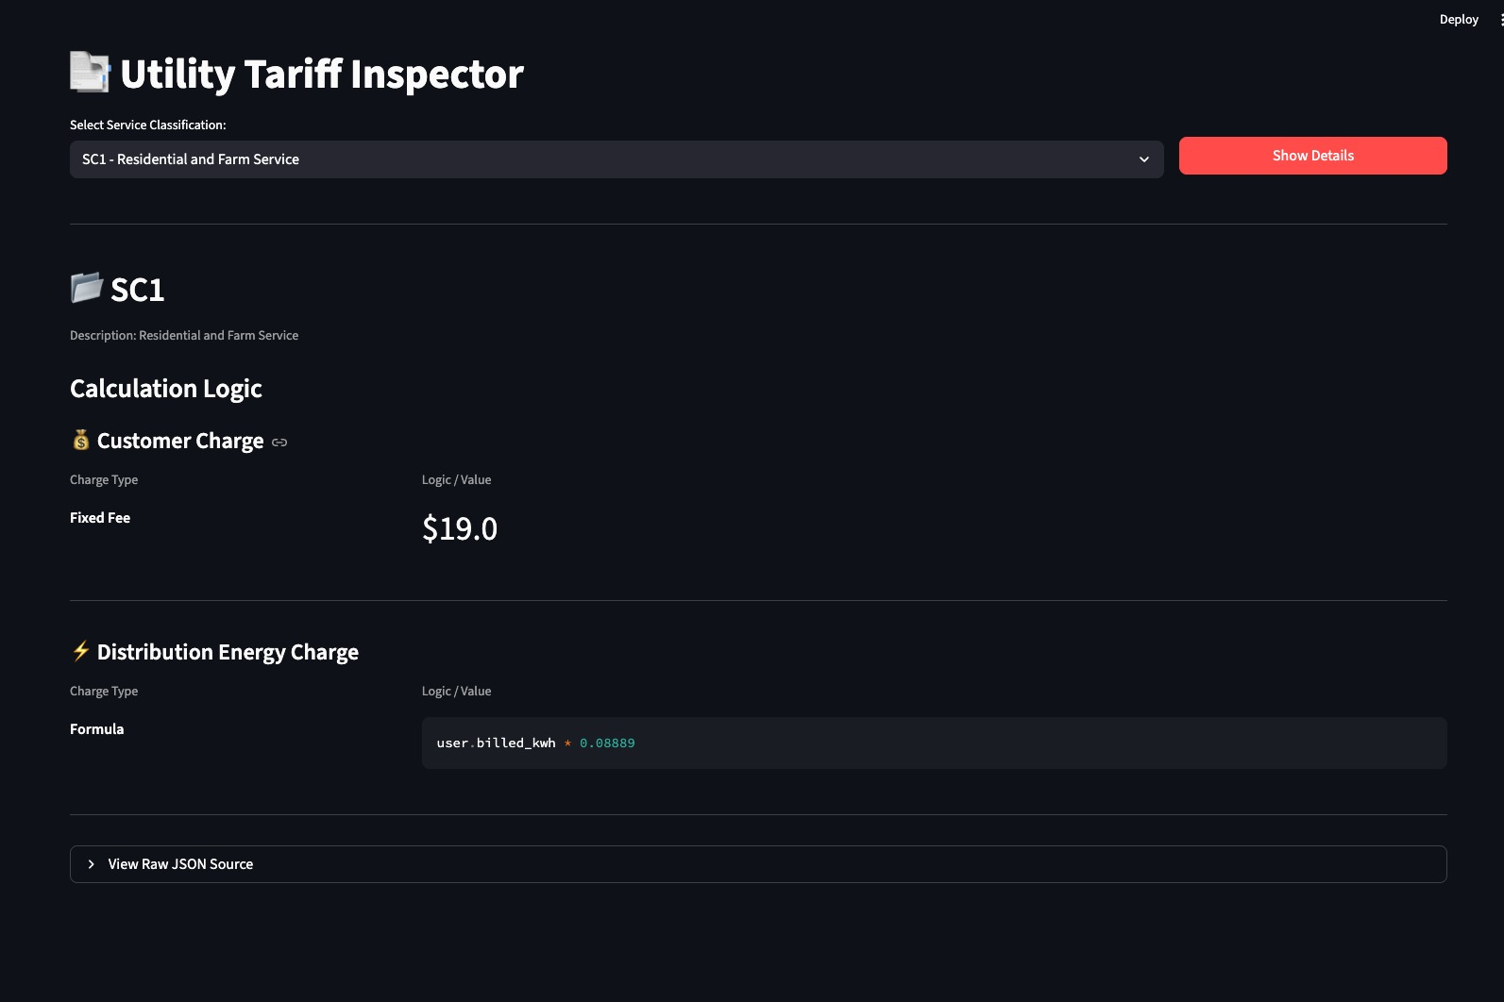
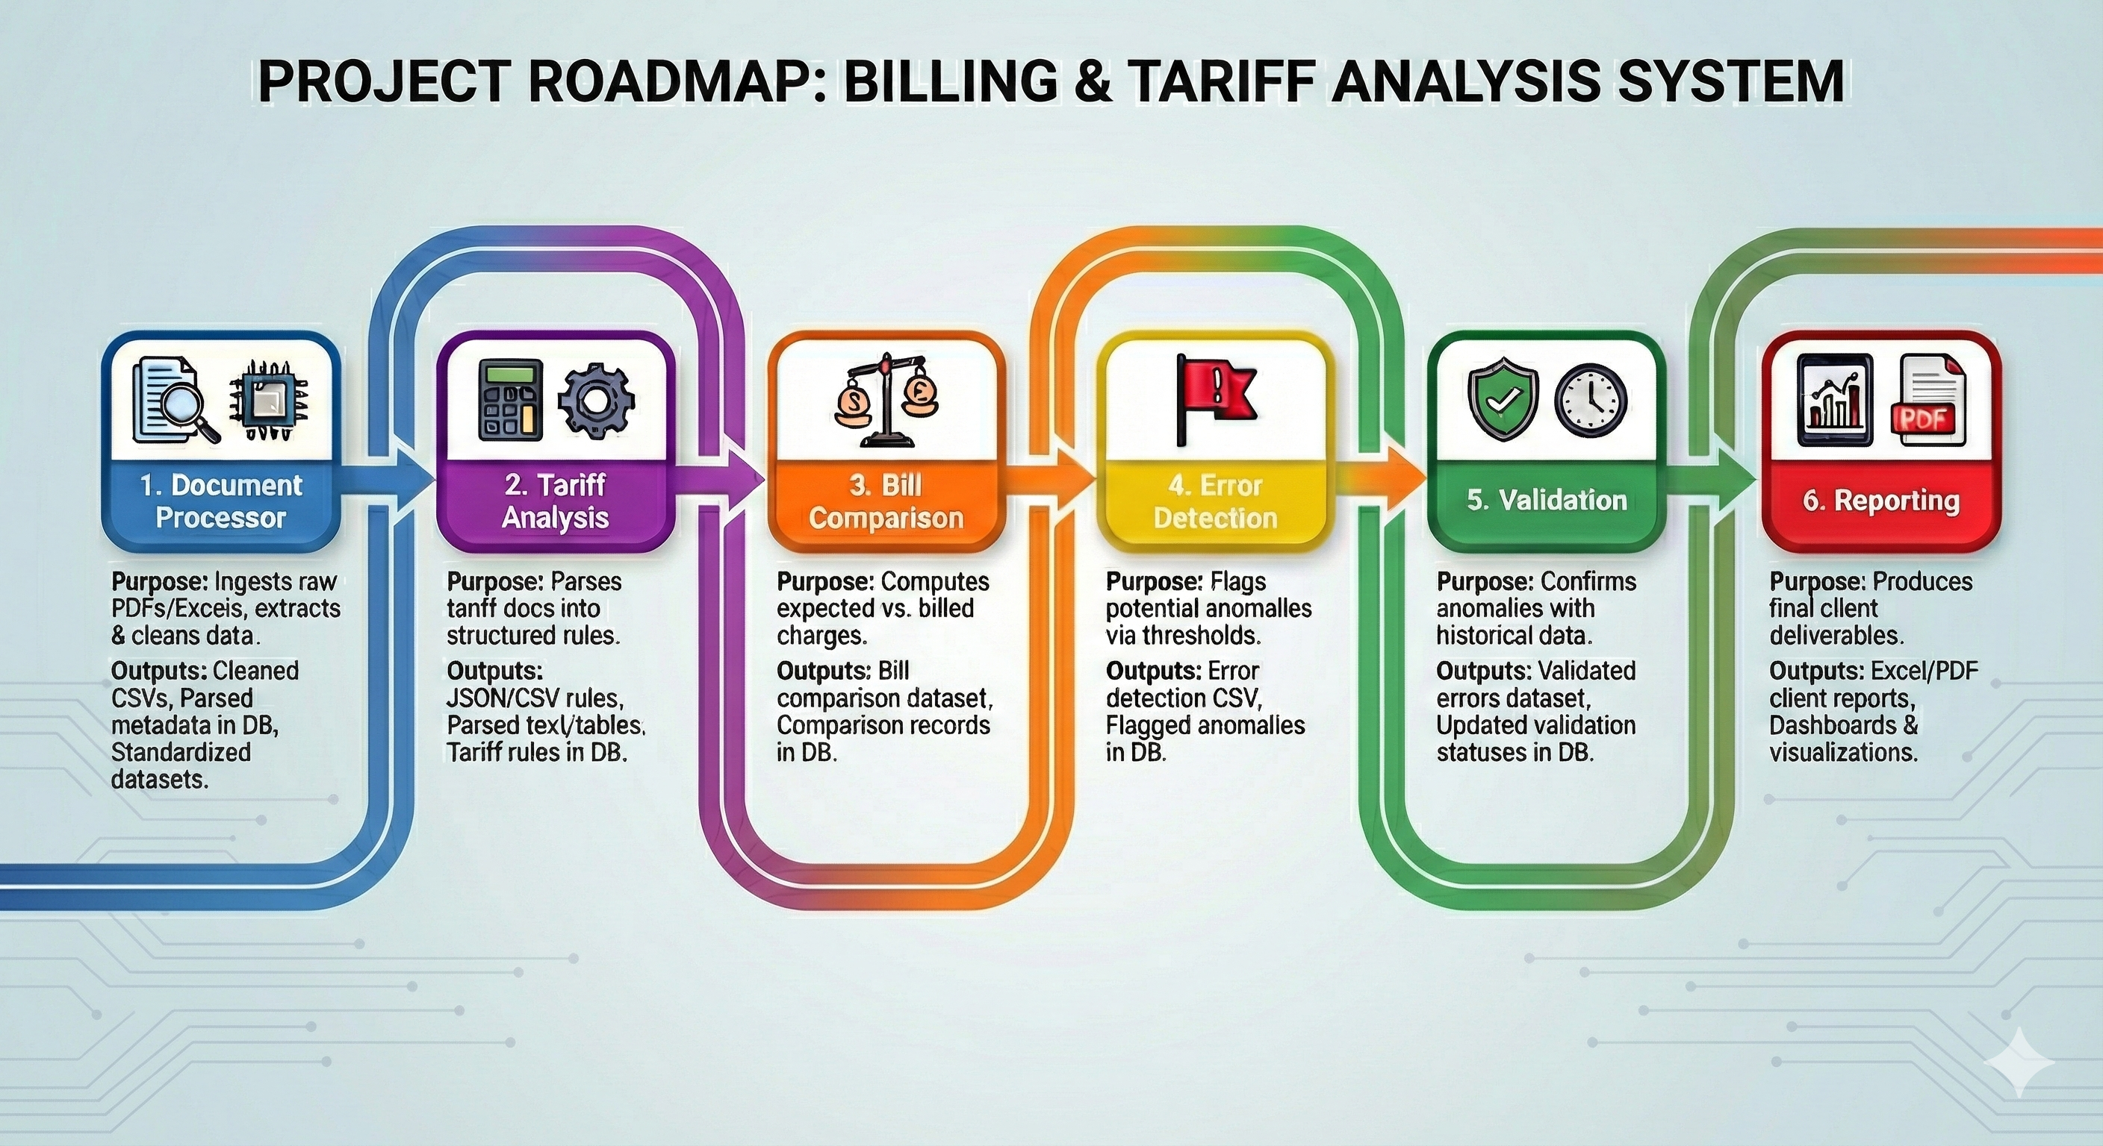
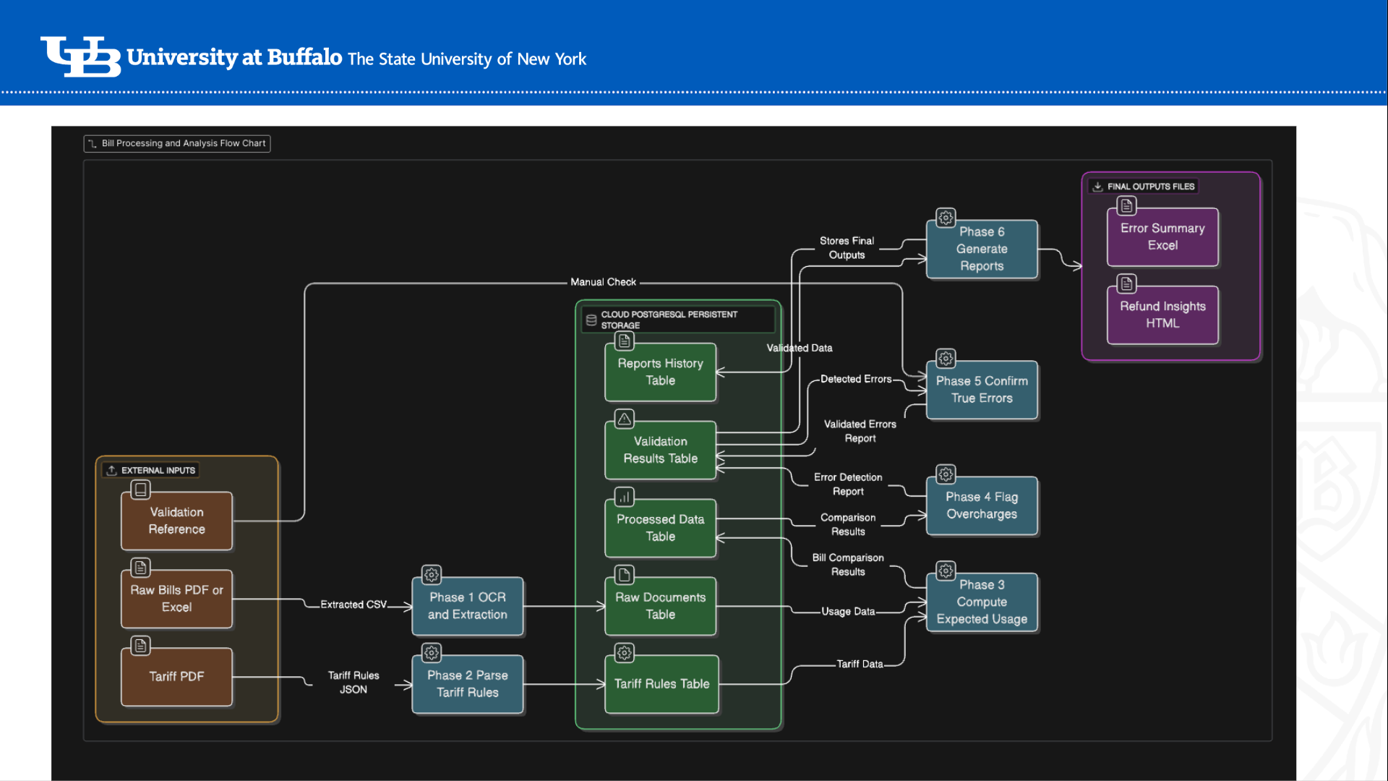
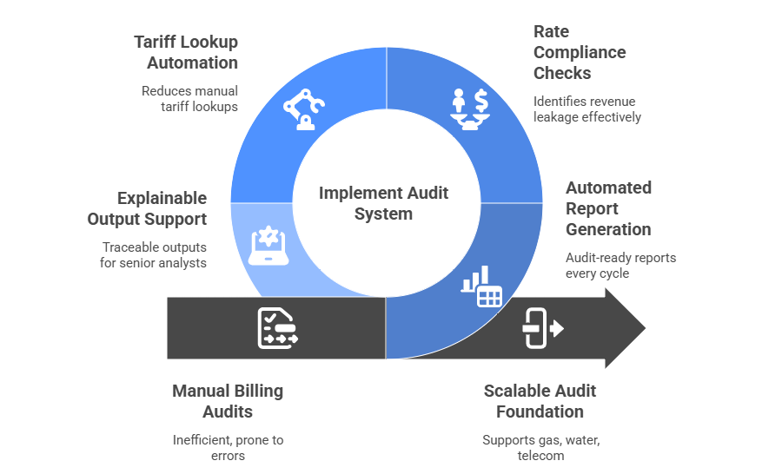
Automated Utility Billing Intelligence System
Team: EagleEye
Harshal Patil, Avipsa Bhujabal, Aarushi Jugran
Problem Statement
Manual bill review faces three key challenges:
High Effort & Complexity: Bills arrive in varied formats (scanned PDFs, tables, multi-page statements) requiring manual extraction and verification.
Tariff Volatility: Service class tariffs (SC1, SC1C, SC2, SC3, SC3A…) change yearly, demanding constant updates to calculation models.
Undetected Anomalies: Usage spikes, incorrect demand charges, and mis-classified service classes often go unnoticed due to volume.
Troy & Banks needed a scalable, automated, auditable solution to accelerate their monthly billing review pipeline.
Proposed Solution
Our solution is an an AI-enabled Utility Billing Automation Platform that extracts data from PDFs and spreadsheets, standardizes it, and recalculates charges using a fully dynamic, JSON-driven tariff engine for all service classes. The system automatically compares recalculated totals with utility-billed amounts and flags discrepancies using hybrid rule-based logic and LLM-generated explanations. All results are stored in a central database and visualized through an analyst dashboard, creating a fast, accurate, and scalable audit workflow for Troy & Banks.
Results
Anomaly Detection
Past 12-month baseline per month
Spike = usage > (mean + 2.5σ)
Demand inconsistencies validated
Bill-days mismatches validated
LLM evaluates narrative: “Does this bill logically follow from historical patterns?”
Project Roadmap
System Architecture
Business Impact
Conclusion
This project demonstrates how AI, rule engines, and automated data pipelines can modernize traditional utility bill auditing. By creating a robust extraction pipeline, dynamic tariff engine, and advanced anomaly-detection framework, we deliver a scalable and accurate solution that enhances Troy & Banks’ review workflow and reduces processing time dramatically.
Future Enhancements
Expand tariff engine to support multiple utilities nationwide
Add forecasting models for consumption & demand
Add anomaly clustering to identify municipality-level patterns
This platform dramatically reduces manual audit time, increases billing accuracy, and ensures consistent tariff compliance across all utilities and service classes. By automatically detecting anomalies and recalculating charges, it helps Troy & Banks identify over-billing, recover potential savings, and deliver faster, data-backed insights to clients. Centralized storage, automated workflows, and clear visual reporting streamline analyst operations, enabling the firm to scale audits efficiently and serve more clients with higher precision.
Department or Office name goes here School, College or Division name goes here
buffalo.edu

Slide 4
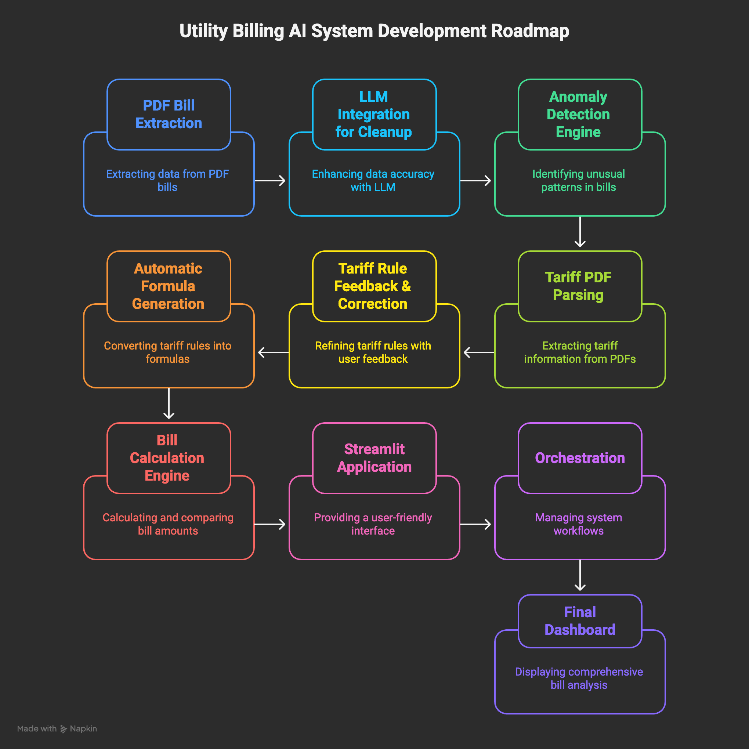
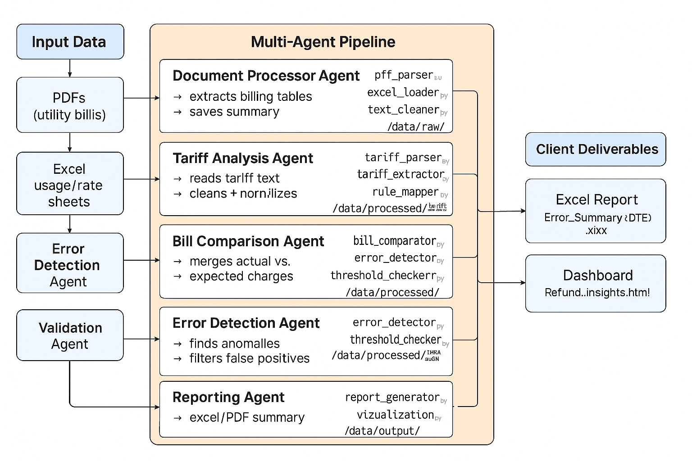
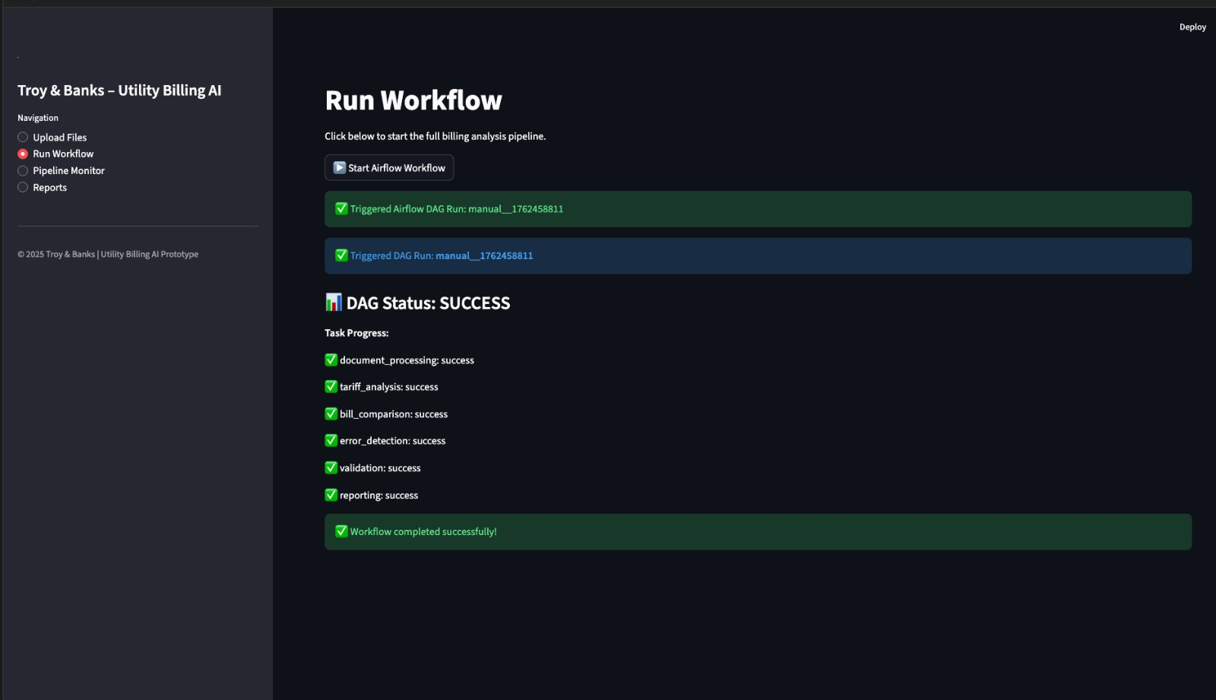
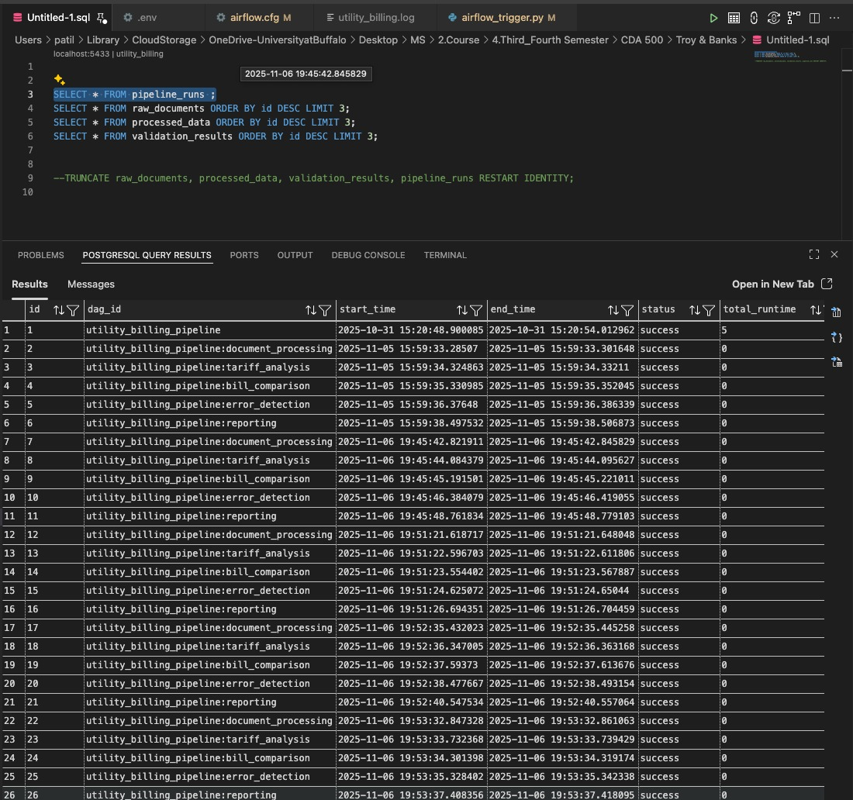
ELECTRIC BILL AUDIT AUTOMATION
Avipsa Bhujabal, Aarushi Jugran, Harshal Patil
Prof. Adithya Narayanan, Prof. Saverio Marrazzo
PROBLEM STATEMENT
Organizations that manage large numbers of utility accounts face frequent billing errors due to complex tariff structures, inconsistent bill formats, and manual verification processes. Monthly bills arrive as unstructured PDFs, requiring manual data entry and manual cross-checking against hundreds of pages of tariff rules. This slow and error-prone workflow leads to overcharges, financial losses, compliance issues, and makes large-scale auditing nearly impossible. There is an urgent need for an automated, scalable system capable of interpreting tariff logic, validating charges, and detecting discrepancies accurately and efficiently.
Data Analysis
TIMELINE
PROPOSED SOLUTION
We present a fully automated, AI-driven billing audit system designed to replace manual verification workflows. The solution integrates tariff intelligence, automated bill extraction, and a rule-based calculation engine to ensure precise and scalable auditing.
Tariff Interpretation & Rule Modeling
Converts complex tariff documents into structured rule sets.
Uses LLMs to extract customer charges, energy rates, demand charges, surcharges, and conditional rules.
Builds formula trees that replicate how utility companies calculate bills.
Automated Bill Extraction
Parses raw PDF bills and normalizes them into a consistent schema.
Extracts usage data, demand, meter reads, rates applied, and line-item charges.
Automated Billing Calculation Engine
Reconstructs the expected bill by applying tariff rules and formula trees programmatically.
Computes:
Customer charges
Tiered energy rates
Time-of-use pricing
Demand charges
All surcharges and special provisions
Generates a precise, machine-calculated bill for comparison.
Intelligent Discrepancy Detection
Compares the system-calculated bill with the vendor-provided bill.
Flags:
Overcharges
Misapplied service class
Missing or incorrect demand charges
Incorrect rate tier usage
Surcharge miscalculations
Produces a transparent audit trail for every identified mismatch.
RESULT
References
Phasellus nec lectus bibendum, posuere nibh id,
Mauris orci mi, varius id diam id, egestas auctor enim
Duis vitae tincidunt tortor, vitae sollicitudin magna
Aenean et est sem. Phasellus nec lectus bibendum,
Lacinia magna. Mauris orci mi, varius diam id, egestas
Mauris orci mi, varius id diam id, egestas auctor enim
Duis vitae tincidunt tortor, vitae sollicitudin magna
*Unamcorper efficitur sed in nulla.
Department or Office name goes here School, College or Division name goes here
buffalo.edu

